Slide 1
Data Visualization and Communication
An Analysis of Suicide Trends in Greece, 2011-2015
Tragakis Iasonas

Slide 2


Data
Our analysis will rely on datasets from Eurostat and the World Health Organization (WHO) for the period 2011 - 2015.
In our analysis we will mainly use sucide rates of a population adjusted to a standard age distribution and calculated on the basis of a standard European population (defined by the World Health Organization). Absolutes numbers or even not adjusted rates are proportional to the population size, so the bigger the population the more the suicides.
Also as most causes of suicide vary significantly with people's age and sex, the use of standardised suicide rates improves comparability over time and between countries as they aim at measuring suicide rates independently of different demographic compositions. Finally in terms of reproducibility of our analysis it worth mentioning that Eurostat and the World Health Organization (WHO) have stopped providing absolute suicide numbers. We will only use absolute suicide numbers for comparisons between age groups and sex in Greece, in order to backup part of our analysis.

Slide 3
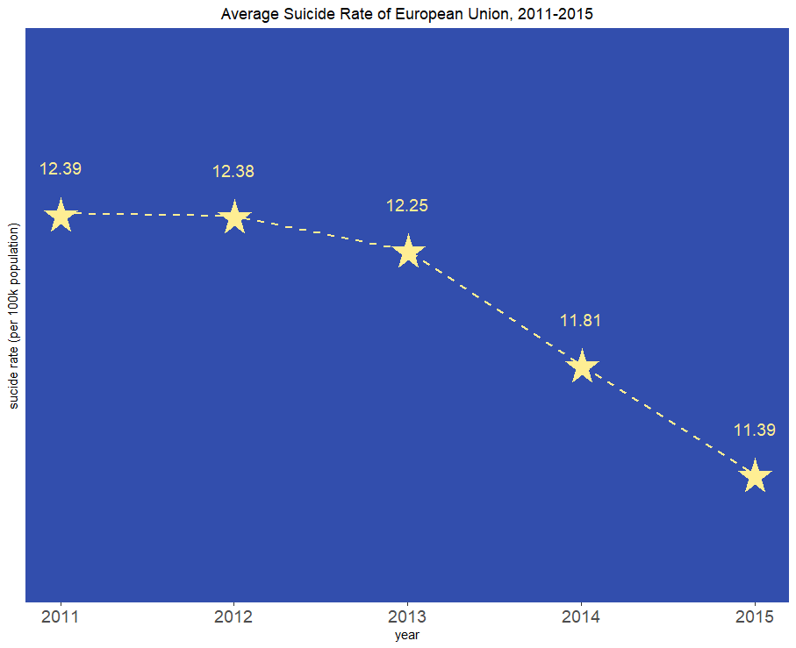
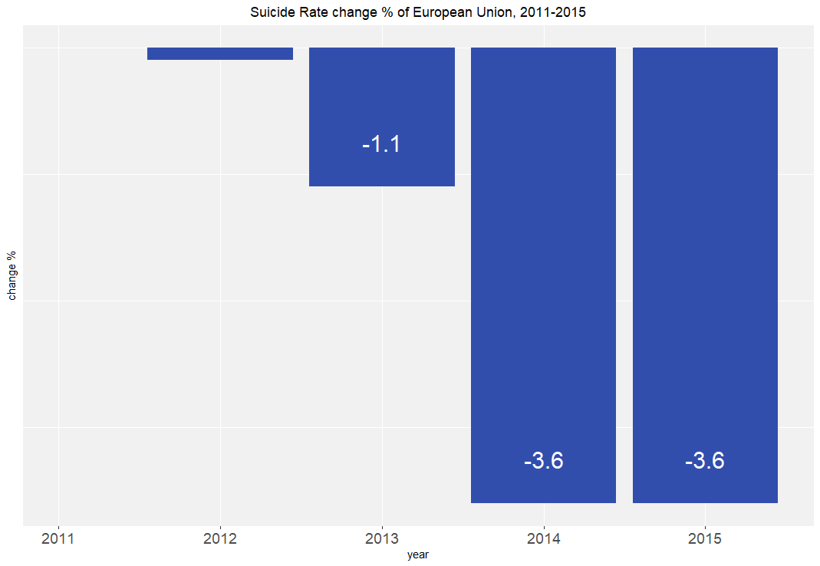
Suicide Trends in Europe
During 2011 2012 suicides remained stable
The following years we inspect a gradual decrease
2011 is the highest peak of 12.39 in 100k people

Slide 4
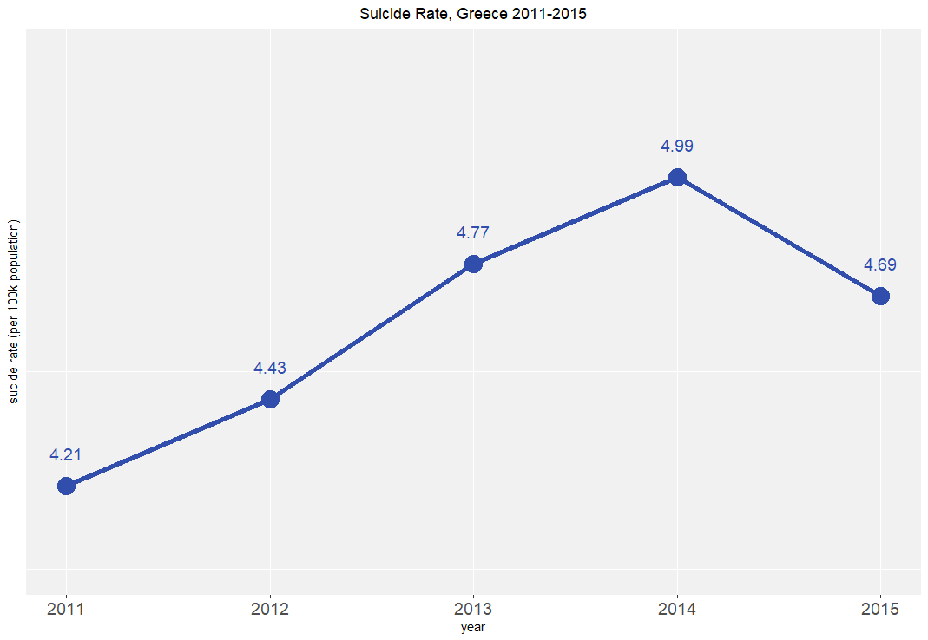
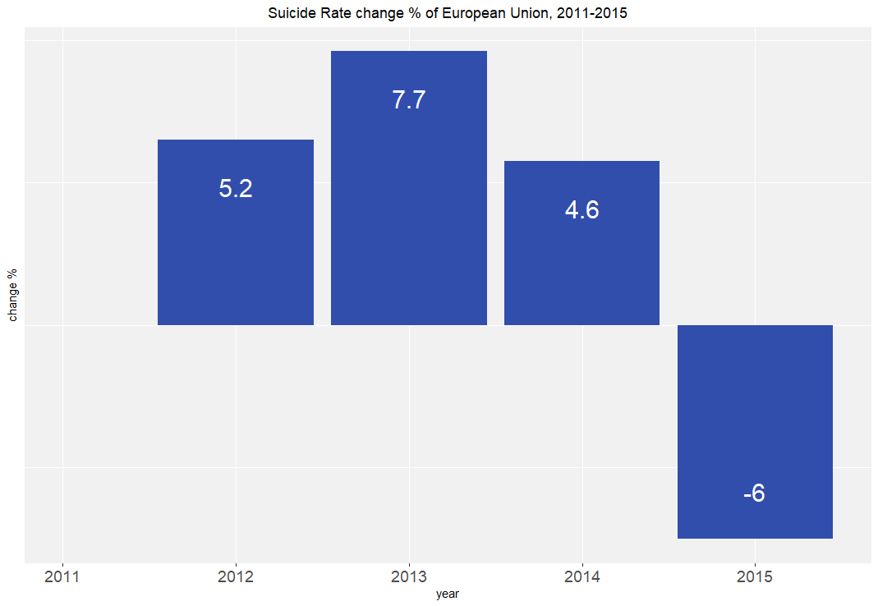
Suicide Trends in Greece
During 2011 2014 we inspect an upward trend
In 2014 we have a peak at ~5 in 100k people, which is followed by a drop 0f 6% to 2013 levels
Greece suicide rate is on average 2.6 lower than EU average
Suicides in Greece seem to follow opposite trend from EU average

Slide 5
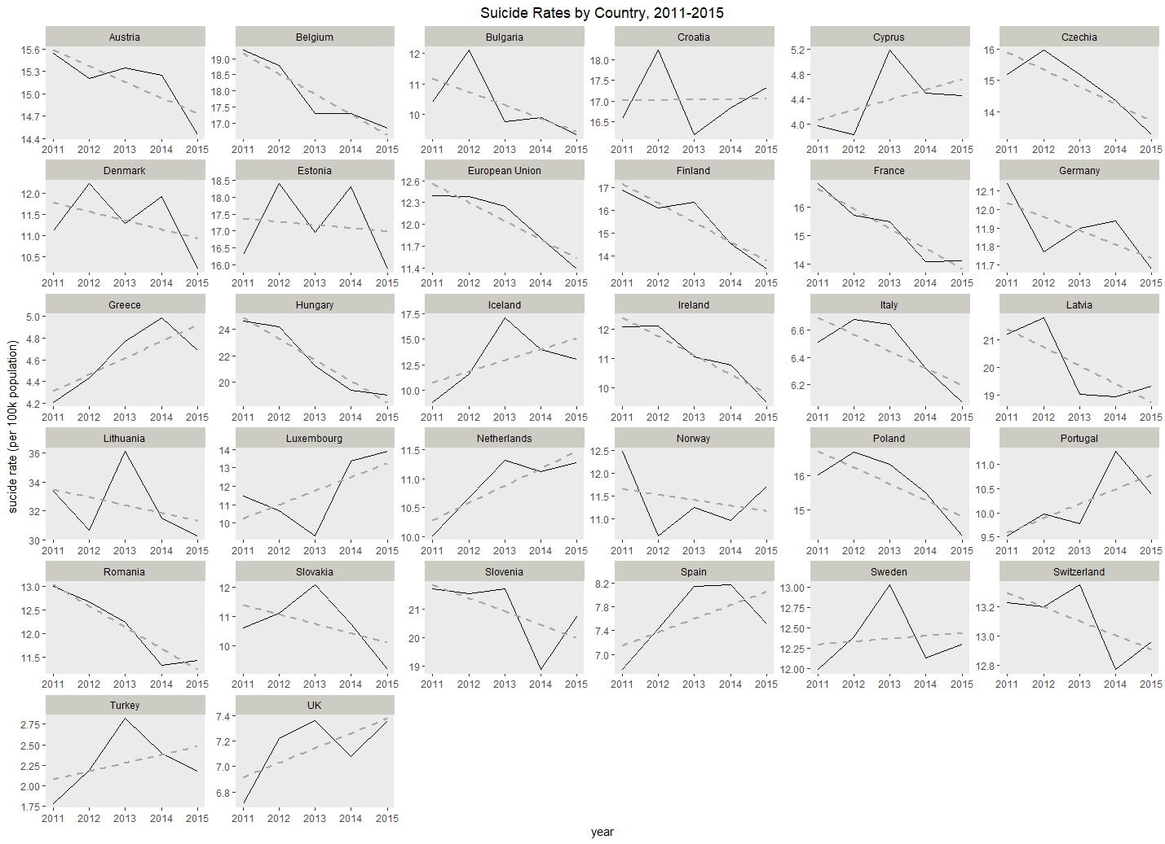
Suicide Trends in Europe by country and year
Greece, Cyprus, Iceland, Netherlands, Portugal, Spain, Luxembourg, Turkey, UK indicate an upward trend
Most of the countries in EU indicate a downward trend or remain stable

Slide 6
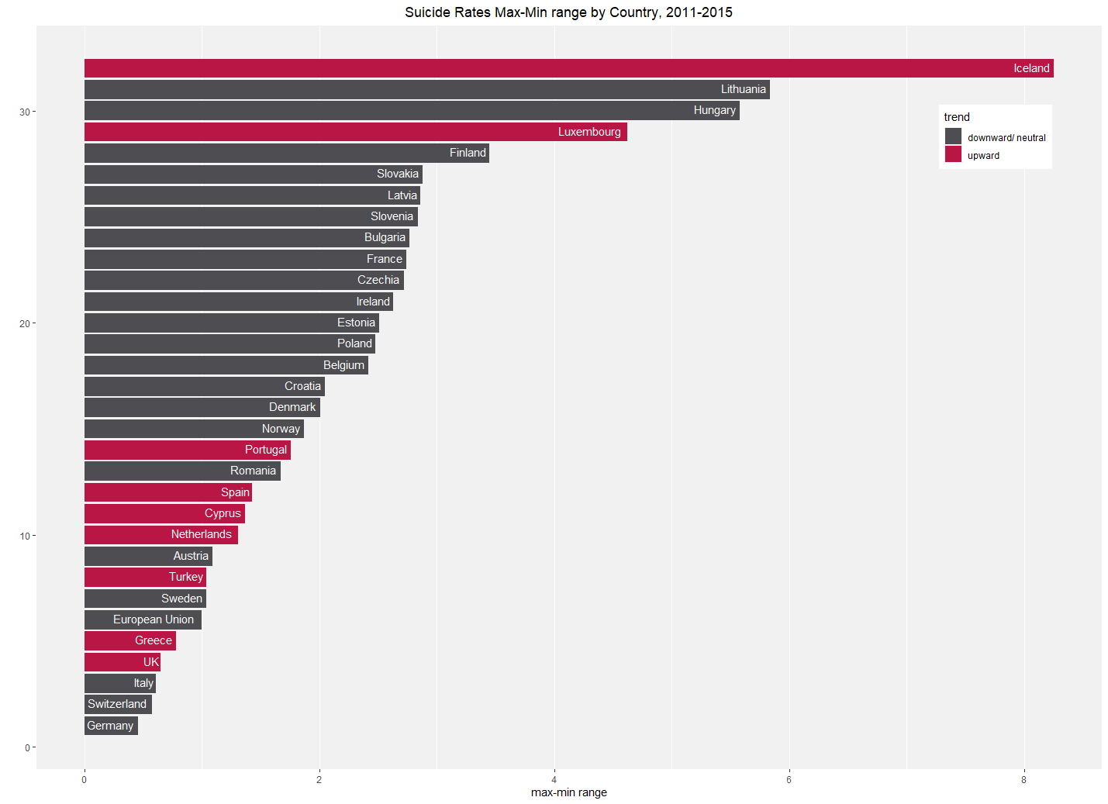
Suicide Trends in Europe by country and year (cont.)
Greece, Cyprus, Iceland, Netherlands, Portugal, Spain, Luxembourg, Turkey, UK indicate an upward trend.
If we inspect y axis scale (or better max-min range) Iceland and Luxembourg showed the highest increase in max-min range, among them.
Even if Greece indicates and upward trend in comparison to the others seems insignificant.

Slide 7
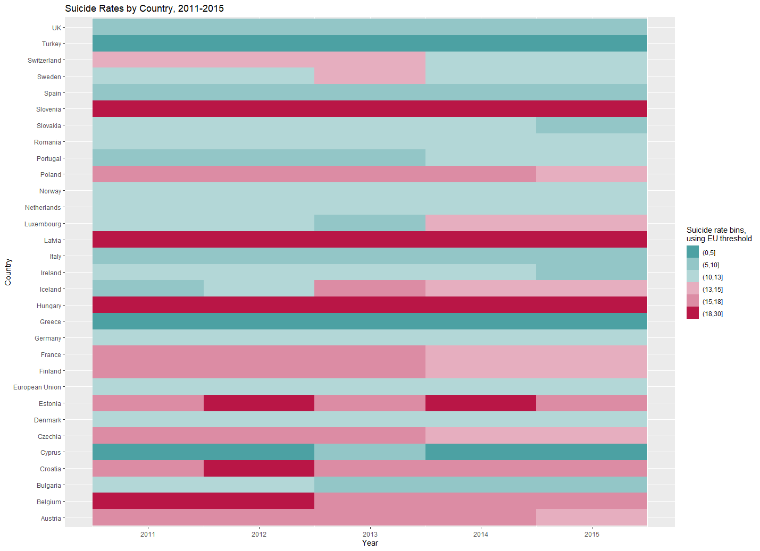
B. Suicide Trends in Europe by country and year
We have used EU average suicide rate (2011-2015) as threshold. Green are the countries with lower rates than EU threshold, red are the countries with higher rates than EU.
Again we see that Greece in comparison to other countries stay dark green during 2011-2015. In others words we can say that Greece remains stable and at low levels.

Slide 8
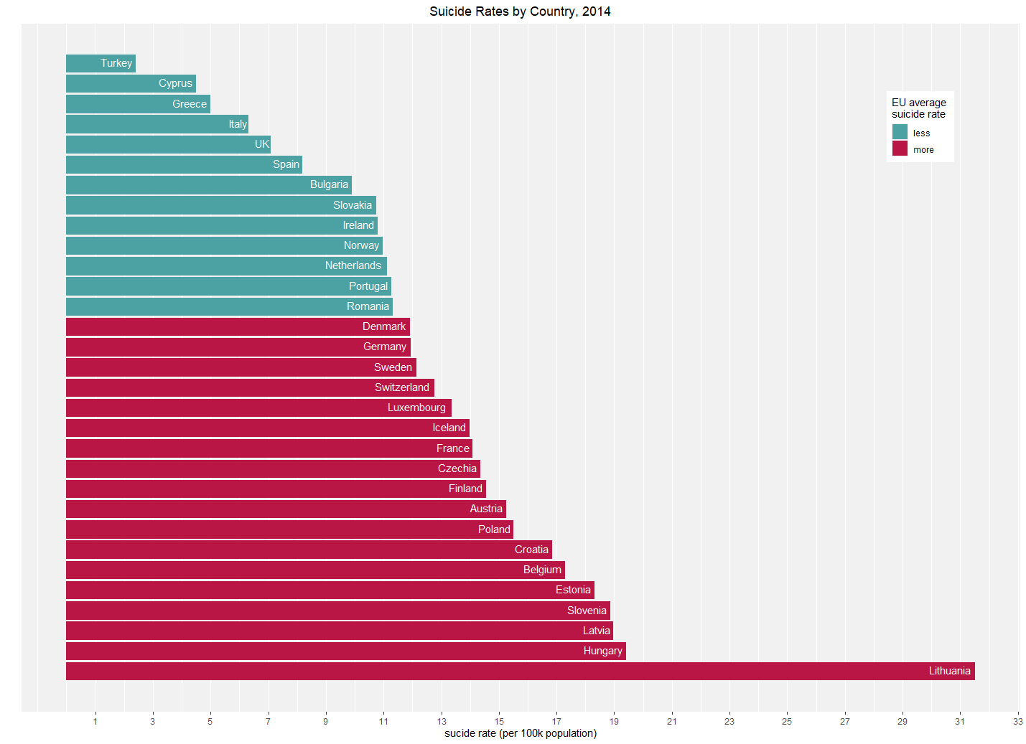
Α. Suicide Trends in Europe by country, 2014
We selected 2014 which Greece has the highest sucide rate during the period 2011-2015.
Again we see that Greece,even in its high peak, is the 3rd lowest among other EU countries.

Slide 9
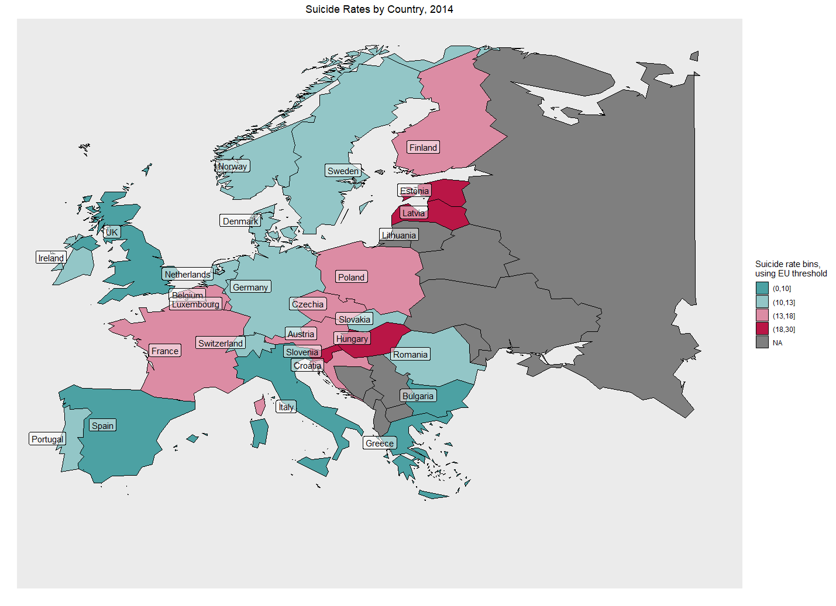
Β. Suicide Trends in Europe by country, 2014
Coastal countries especial Mediterranean counties seem to have lower suicide rates than continental countries.

Slide 10
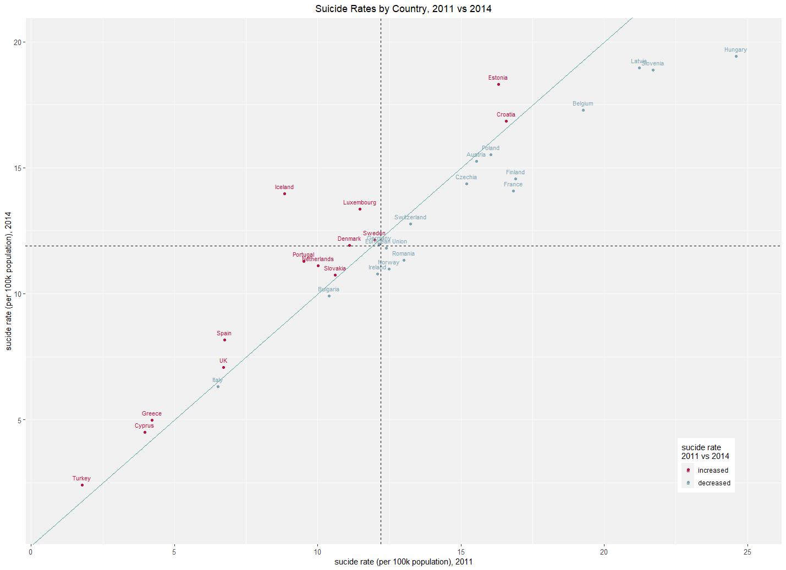
Suicide Trends in Europe by country, 2011 vs 2014
Countries that are located on near the x=y line, indicate a small change. Counties far from the line, indicate a big change.
Countries with red color indicate that suicide rate increased. Countries with green color indicate that suicide rate decreased.
Dashed lines pass through EU suicide rate.
Greece is at the bottom left square and near the line, even if it has red color.

Slide 11
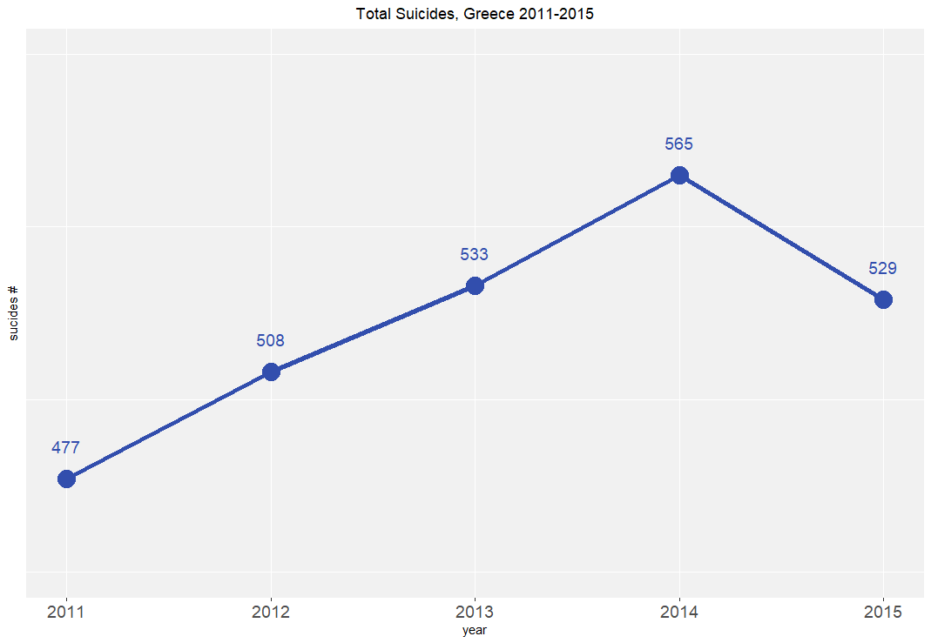
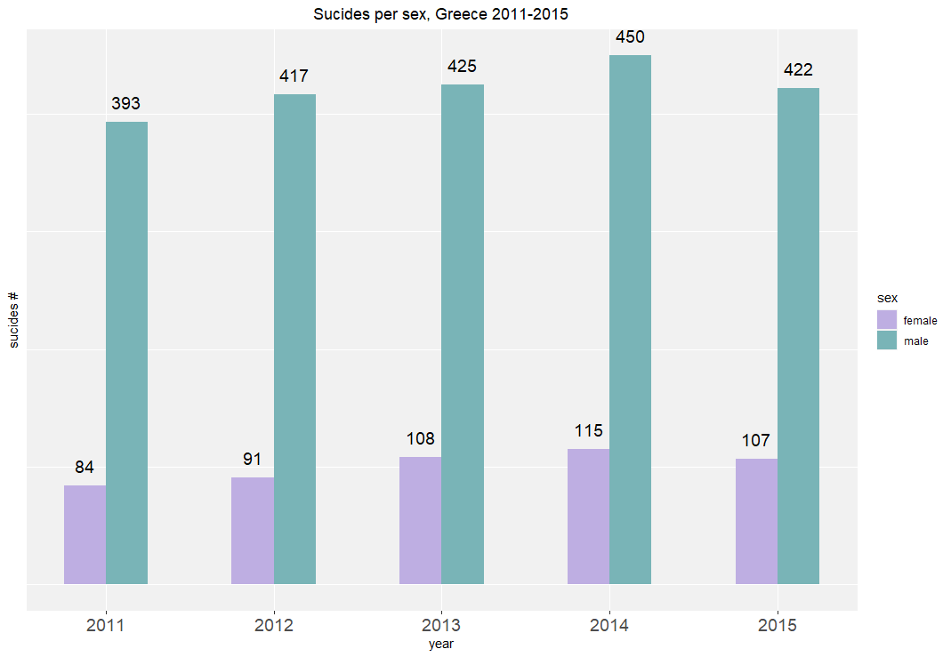
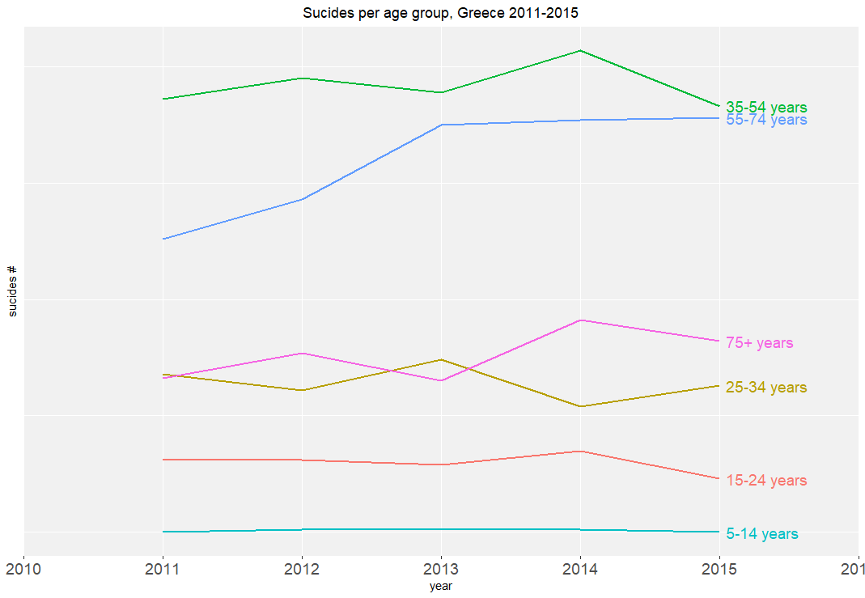
Suicide Trends in Greece, 2011-2015
In Greece on average 520 people commit suicide per year, and in its high peak we had an increase of 40 people.
We can inspect that mostly males commit suicide (~4x more than females) and mostly people between 35-54 years (following by 55-74 years).
Based on Greek standards we will assume that people between 35-54 and 55-65 years old belong to the working age population and are independent from family financial support.
Next we will examine if there is a correlation between suicides and economic factors such as GDP and long term unemployment.

Slide 12
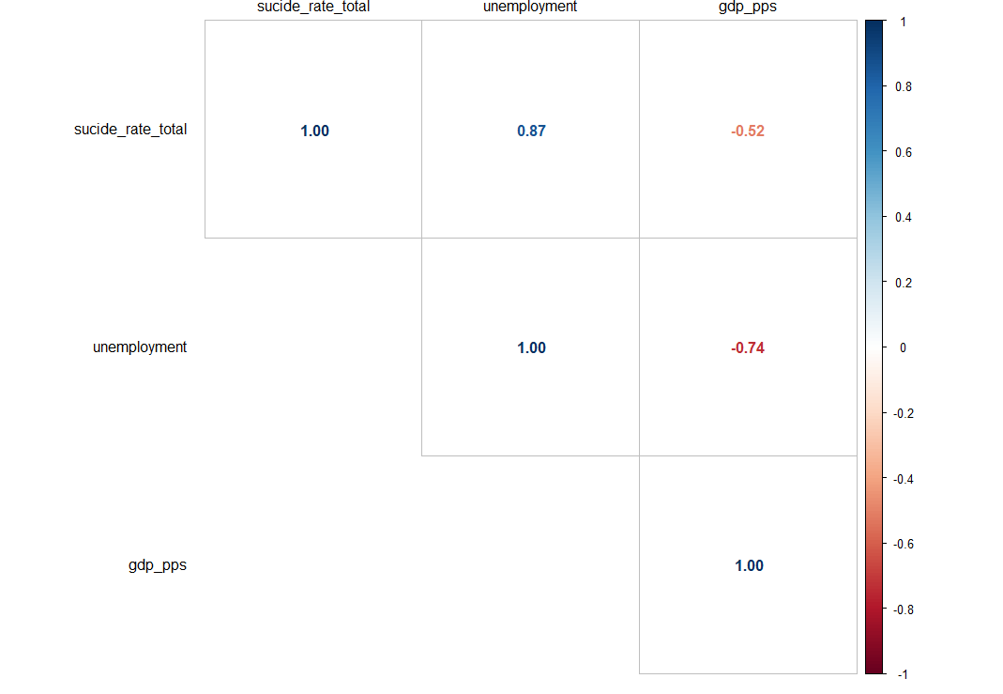
Suicide Trends in Greece, Correlations
Unemployment is defined as the percentage of unemployed people divided by the population in the labour force for the age group of 20-64 years.
GDP PPS is defined as GDP per capita in a common currency that eliminates the differences in price levels between countries allowing meaningful volume comparisons and is expressed in relation to the European Union average set to equal 100.
From the correlation analysis we can inspect that there seem to be a significant correlation between suicide rate and unemployment.

Slide 13
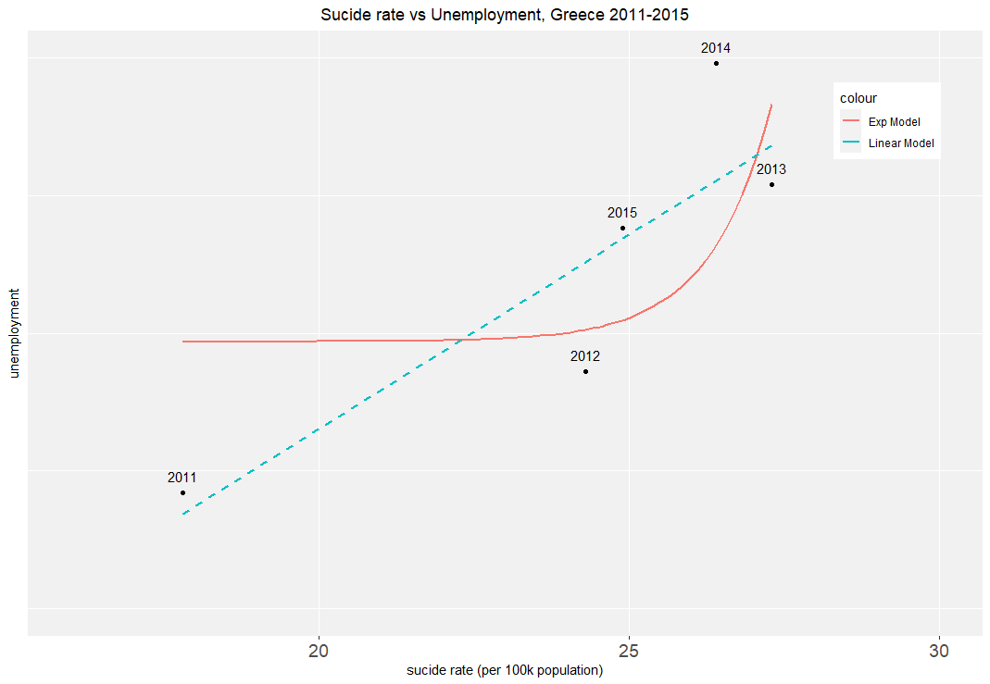
Suicide Trends in Greece, 2011-2015
Graphically we can also support that there is a correlation between suicide rate and unemployment.

Slide 14
Conclusion
Suicides in Greece seem to follow an upward trend in comparison to most of EU countries.
Even the upward trend, increase rate of suicides is lower than that of most of the other EU countries, that showed upward trends.
Greece is on average the 2nd or 3rd lowest in EU, in terms of suicide standardized rates.
In Greece Males seem to be far more prone to commiting suicide than women. Also people between 35-74 are of greater risk.
In Greece there seems to be a correlation between the upward trend of suicide rates and the increase of unemployment.

